Slide 1
Western States Sheriff’s Association Annual Conference Reno, NV
The Impact of Federal Agencies and Outside Influences on Rural Counties
A Case in Point:
Skamania County, WA
March 3, 2019

Slide 2
Skamania County, WA
Vancouver
Portland, OR
Notes:
Skamania County is located in Southwest Washington. Stevenson, the County seat is 42 miles east of Vancouver, WA.

Slide 3
Notes:
The County is home to the Gifford Pinchot National Forest and the Columbia River Gorge National Scenic area.
Visitors who wish to explore the area are encouraged to obtain a topographical map as the majority of the county is extremely rugged and paved roads are at a premium. Proper clothing and footwear will help insure a safe and enjoyable visit. Windsurfing, Kiteboarding, kayaking, camping, and hiking are a few of the many activities available. Being prepared will help reduce the strain on our limited emergency services.

Slide 4
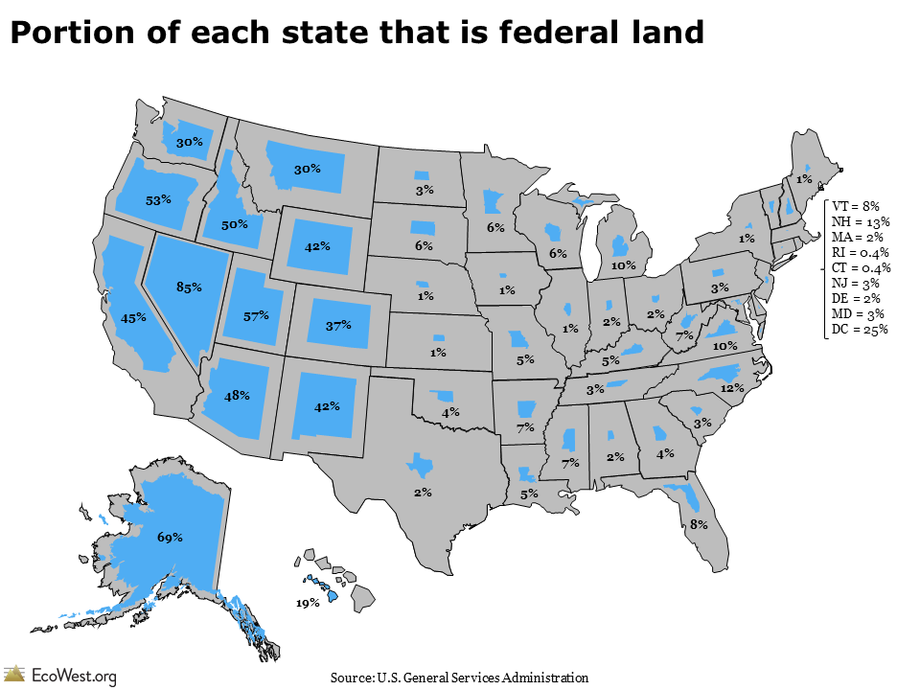
M
Notes:
Here is one of our problems: a huge amount of the land from the Rockies west is managed by the Feds, and our States and Counties are denied the tax revenues which could support rural counties as well as other state programs. For Washington, it's 30% of our state. The income Skamania County would receive if the Gifford Pinchot National Forest were taxed as "Open Space“ (lowest Tax level) would produce more than $18 million/Yr. This is what we gave up when we accepted the original agreement to receive 25% of all Forest timber receipts back in 1908. There would be no need for SRS (Secure Rural Schools) or PILT (Payment in Lieu of Taxes) payments.
This is a visual representation of the Federal Land distribution in the United States. This illustrates the fact that the Western States (including Alaska) are comprised of 45% federal lands. Consequently, Federal Forest Management is largely a Western States issue, although Federal Policies impact any state with Federal Lands of any size.
Ever since the 1970’s restrictive laws and agency policy has continually whittled down the revenue streams available to timber counties with Forest Service or BLM lands.
Data is from the U.S. General Service Administration.

Slide 5
Where the votes are:
80% of our population resides on 4% of the land.
M
Notes:
Most of the support for many of the wrong minded Federal programs is from folks who do not live in these rural areas; we are at their mercy as they are well funded and lawyered up. Today, more than 80% of our nation’s population resides on less than 4% of the land, so the number of folks in the US House of Representatives and the Senate who represent us is very small. The U.S. has one of the highest concentrations of urban population densities in the world.
Yet, most all things people in those urban areas use and consume comes from rural America: food, energy, lumber, cement, exotic minerals for cell phones, flat screen TVs, and cars etc..
The three sources of basic supplies for any society - Agriculture, Timber and Mining - come from rural areas. There would be no urban areas without the bounty of rural America.

Slide 6
Skamania County Lands Taxed at FMV outside the CRGNSA*
Total County = 1,070,000 acres
Total lands taxed at Full Market Value = 19,000 acres
Dotted line at bottom designates boundary of the Columbia Gorge Scenic Area.
White area below the dotted line is restricted by the Scenic Area
Grey areas at bottom are “Urban Development Areas.
Black areas are lands outside of the Scenic area that are taxed at FMV and available for development.
Shaded areas above the Scenic Area boundary dotted line are wilderness areas of the Gifford Pinchot NF and the Mt St. Helens monument.
*Columbia River Gorge National Scenic Area
Notes:
In addition to the National Forest, we also are home to the Columbia River Gorge National Scenic area. It is comprised of about 87,000 additional acres. Development is severely restricted in about 72, 000 leaving about 8,000 in Unban Development areas. Which is where most all of the current development already resides.
Over the life of the Columbia River Gorge National Scenic Act, the Forest Service has purchased about 17,000 acres in the Scenic Area and taken them off of our private property tax roles. The continued removal of taxable land constitutes ”death by a thousand cuts” for our local schools, roads and services. Over the past 20 years the cumulative effect has been that the county has now lost more than $720,000 /year in private property taxes to the federal agencies and non-profits. Current Property taxes generate about $12,000,000, so the loss is 6% of total taxes. They continue to seek more land, while the cost of county government continues to rise. WASAC Washington State Association of Counties) estimates the cost of county government in Washington State has increased more than 27% since 2006. Property taxes have increased 10%.

Slide 7
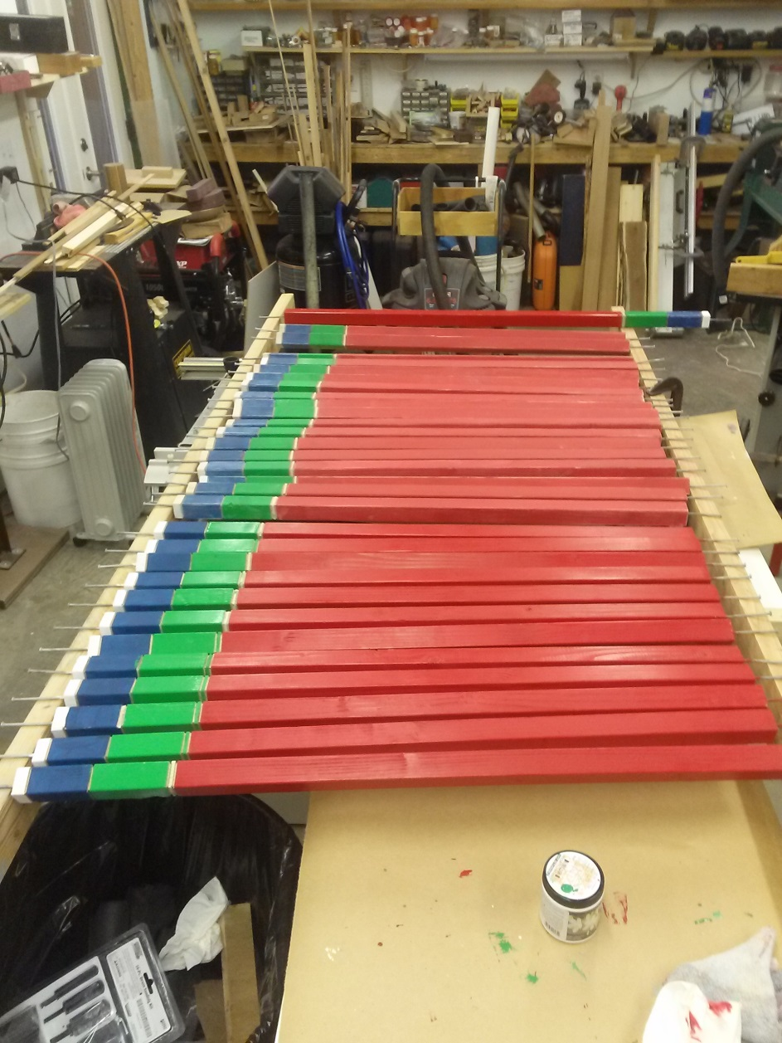
What do you mean only 1.8% is taxable at Full Market Value?
Here’s a set of sticks that explain how we ended up with such a low % of fully taxable land:
Red = Federal - Never Taxed
Grey = Preserves/Fisheries – Never Taxed
Green = private timber taxed when cut – once every 35 to 45 yrs
Blue = State DNR land providing revenues from active management of State Forest and School Boards Lands
White = Land taxed at full market value
1.8% of our land mass
And that’s how Skamania County got the short end of the Stick!
Notes:
When the County CoMMissioners issued a Financial Crisis Declaration in 2013, we learned that only 1.8 % of the County’s 1.1 million acres could be taxed at full market value. A mere 19,000 acres. We needed a more graphic tool to make this point. We’ve made and distributed more than 80 to members of the House and Senate in DC, and many other Federal and State officials.

Slide 8
Timber Related Private Employment Skamania County 1970-2012 Big Picture: NWFP -Over 316 mills closed and 33,000 jobs lost.*
Ave. 646 Jobs
* Sierra Institute for Community and Environment 2012
WA. State Employment Dept.
Notes:
Over the period from 1970 until the passage of the NWFP, the county supported an average of 646 private timber related jobs, possibly more. These included most all jobs directly related to the harvesting and processing of timber, including loggers, drivers, mill workers and staffs. Regardless, the loss of over 550 jobs had a substantial negative impact on us, to say nothing about that impact on the hundreds of other non-specific jobs that went with that loss. This played out across many of the other 79 counties in Washington, Oregon and Northern California.
We do not believed that these numbers included hundreds of U.S. Forest Service jobs that were in the county. Estimates are that there were between 340-400 Federal Forest Service employee, most of who lived in the county. We now have an average of 100 jobs in the timber industry. This decline clearly occurred because timber harvesting fell dramatically.

Slide 9
Comparison of SRS vs Timber Harvest Payment Options
Notes:
After the timber production was shut down by the Northern Spotted Owl listing, the Federal government created an offset program known as the Secure Rural Schools Fund (SRS). All impacted counties had the choice of taking the 25% of actual production or the SRS funds, the choice was pretty obvious. It is usually considered “welfare” by the locals, our preference is for Forest related jobs that provide family wage jobs that support our schools and county governments through taxes.

Slide 10
Federal Payments in place of Timber Revenue OWL & SRS Funding (Secure Rural Schools)
Cliff #1 SRS
Congressional Cuts
T
Notes:
When the actual timber harvest receipts stopped in 1990, we were given the choice of Secure Rural School payments or timber receipts. That was a no brainer as the SRS was 8-12 times greater than the timber receipts!
The biggest hit came in 2010 and if Congress does not approve a new round we’ll be looking at another round of layoff in 2018. These will be even more difficult as we’re down to the bone now. $1.3 million will represent about another 10-12 county jobs. The schools are facing a similar situation.
First two columns are production revenues, a friend refers to the rest as “Plunder” i.e. Taxpayer dollars instead of timber receipts which create jobs and strong rural coMMunities.
In 2016 the U.S. imported more than 12 Billion Board Feet of lumber, primarily from Canada. That 30% of what the country used that year! That’s a staggering loss of 10’s of thousands of direct timber jobs and their wages and billions of dollars flowing our of the county.

Slide 11
Skamania County GP Forest Revenues & SRS
1986-1999 = Timber Receipts @ 25%
2000-Current SRS payments

Slide 12
Skamania County Current Expense Budget: REVENUE Sources – 2018 $13,082,252
Private Holdings Harvest Tax
PILT Rock Cove
PILT CRGNSA (Gorge FS)
Federal Forest Funds (Timber receipts)
PILT Fed
PILT -Fed USFW
Timber Sale ST Forest BD Purchase
DNR PILT State NRCA
DNR State Forest Board Encumbered
DNR Timber Sale-State Forest Transfer

Slide 13
Skamania County Employees
T
Skamania County Auditors Office – Current Expense Budget
Notes:
The trend is clear: as SRS funds declined, the county made adjustments to its staffing levels. The overall impact of the loss of these jobs is staggering. Today, we have 40% of what there were in 2008. January of 2018 could bring another loss of 10-12 county jobs if we cannot make up the SRS funding loss.
Our recent January 2017 ice storm was a real stretch in getting our roads opened. Folks were asking why we hadn’t gotten to their road - the answer was in 2008 we had 43 workers in our Road Crews, now we have 12.
Today, Property Tax contributes only 16% ($2.2 Million) to the County's Current Expense budget. That's the one that pays salaries/wages and keeps the lights on and the offices open.
Compare that to a state average of 40+%. Another 24% ( $3.3 million) comes from revenues generated by the other departments. The remaining 60% comes from unpredictable sources such as private timber sales, DNR Forest Trust funds, State Encumbered Lands funding and Federal Forest receipts.
Of particular concern is that as we cut County government and schools jobs, we are losing substantial numbers of the best paying jobs available. This greatly impacts the local economy and the tax base.

Slide 14
Weekly Wages by County Skamania County Average is 58% of Washington State Average
Skamania County wages rank 37th of 39 Washington Counties
Notes:
Our average weekly income is substantially below the State average and neighboring counties. The number of workers that live here but work elsewhere is about 3100 vs those who stay-2200. Because of our extremely limited development (All of which is concentrated in the center of the inhabited area along the Columbia River and lies within the Columbia River Gorge National Scenic Area) - they tend to spend their wages where they work.
Those who leave the county tend to leave most of their spend outside the county. Those who work here do the same to a slightly lesser extent. Of the 2200 jobs in the county about 300 of them live outside the county, so their paychecks also leave the county.
Add to this the proximity of Oregon with no sales tax and the State estimates that Clark and Skamania counties lose about 25% of sales tax revenues to purchases residents make across the river.

Slide 15
Per Capita Annual Spend Comparison A measure of Economic Strength
Washington State Dept. of Employment Security & BLS -2015
Notes:
We wanted to see how much money was “turned over” or “spend per capita” each year in our county, looking at it as an indicator of economic health. We merely divided the total taxable spend by our population and compared it to our neighboring counties and the State.

Slide 16
Current Situations
SRS
Last payment approved for 2018 (Payment due by April?)
SRS Title II and III payments intact
Counties and Schools currently lobbying for extension
Supported by NACO, NEA and many others
Future unknown
For non-SRS counties that receive PILT funds, potentially smaller payments as more counties are getting a piece of the pie if SRS not approved.

Slide 17
Current Situation 2
Stewardship sales now approaching 50% of harvests on many forests, if SRS not approved, timber sale receipts are reduced.
GNA Activities (Good Neighbor Authority) increasing, but currently no revenue stream for Counties (150+ now in play)
Newly announced “Shared Stewardship Program” focus on Fire Management
Recent Wyden-Crapo legislation is idle
Forest Management for Rural Stability Act of 2018
Should we support it?

Slide 18
Possible solutions?
Is there a balanced approach?
Is there a way to replace SRS with a program that also benefits the distressed counties timber infrastructure.
Explore ways to work with the FS to find solutions to take to Congress.
Is it possible to make-up the Arrearage? Gifford Pinchot Example
Original ASQ = 52 Million BFY
52 MBFY X 22 Yr. 1,144,000,000 BF
Actual = 451,000,000 BF
Shortfall = 693,000,000 BF
Be pro-active in understanding current or proposed legislation
E.g. Wyden/Crapo Bill

Slide 19
GPNF Annual Timber Yield -1970-2017 Past – Present and Future Potential Average Harvest 1970-1996 = 326 million BF/yr. Average Harvest 1996- 2017 = 20.5 million BF/yr.
Annual ASQ = 52 Million BF

Slide 20
“Without natural resources life itself is impossible. From birth to death, natural resources, transformed for human use, feed, clothe, shelter, and transport us. Upon them we depend for every material necessity, comfort, convenience, and protection in our lives. Without abundant resources prosperity is out of reach.”
Gifford Pinchot
Notes:
A thought from our Forest’s namesake.

